Slide 1

AAIDM: Data Science 1: Introduction to Datascience
Bram Heijligers & Nitin Bhushan

Slide 2

Introduction Lecturers
Bram Heijligers
PhD-candidate [title], 2020 - Ungoing; Tilburg University
MSc Cognitive Science and Artificial Intelligence, 2018 - 2020; Tilburg University
BSA International Game Architecture and Design – Design and Production, 2012 - 2018; Breda University of Applied Sciences
Neuro-cognitive research into learning and game experience
Game Design and Project management
(Mixed-Reality) Educational Games
Managing Covid-19 Contract Tracing Operations

Slide 3
Introduction Lecturers
Nitin Bhushan
Qualifications?
Portfolio and work experience

Slide 4
What is data science?
Somebody who solves problems & questions using data and various statiscical analyses in a computirized environment.
Bla bla

Slide 5
What is data?
Example 1
Example 2

Slide 6
Qualitative Data
Example 1
Example 2

Slide 7
Quantitative Data
Example 1
Example 2

Slide 8
How do we describe an object?
Large
Long
Old

Slide 9
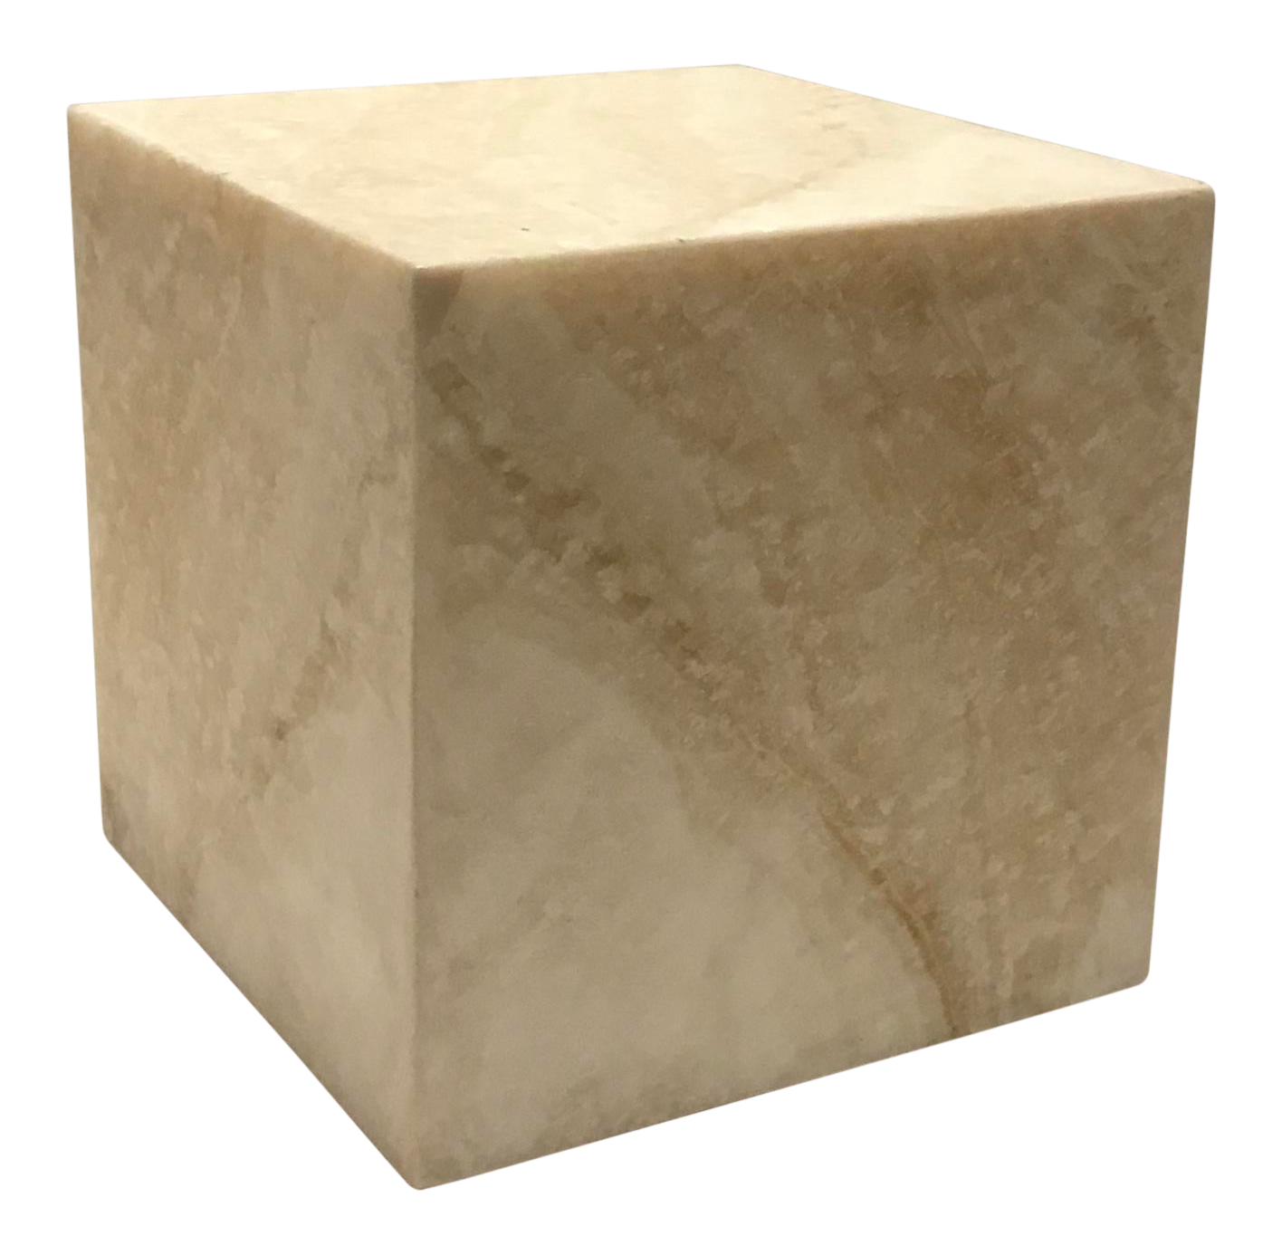
Objects quantified to data
Variables:
var1
Notes:
Mass
Weight
Height
Age
Orientation
Position

Slide 10
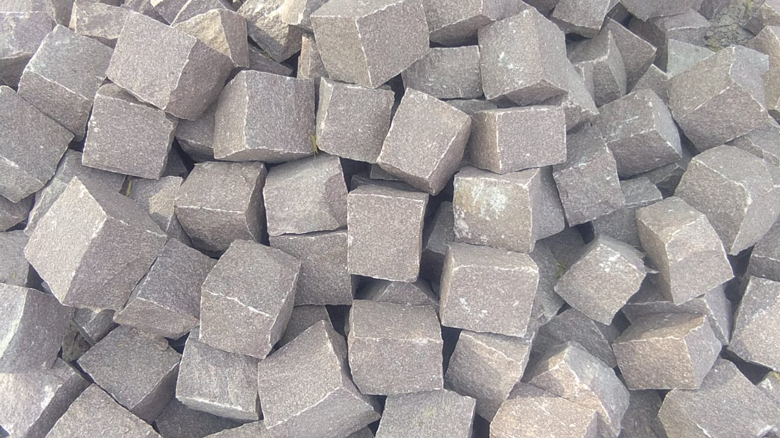
Objects quantified to data
Variables:
var1
Notes:
Mass
Weight
Height
Age
Orientation
Position

Slide 11
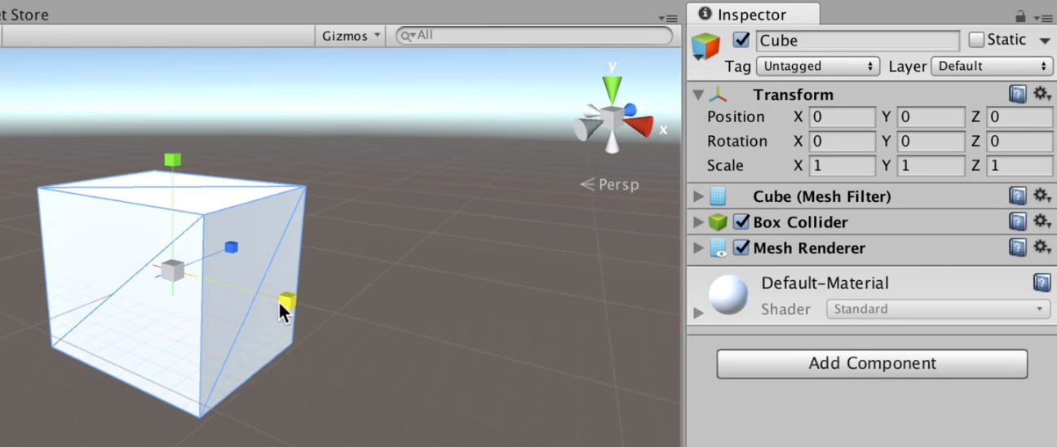
Objects quantified to data
Variables:
var1
Notes:
Mass
Weight
Height
Age
Orientation
Position

Slide 12
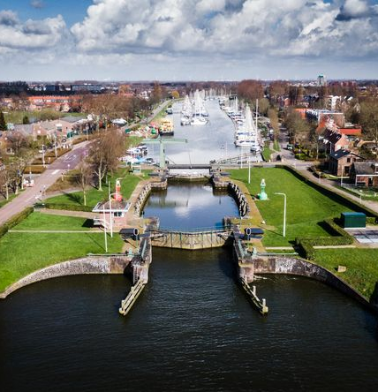
Objects quantified to data
Variables:
var1
Notes:
Mass
Weight
Height
Age
Orientation
Position

Slide 13

You in data; QS
Example 1
Example 2

Slide 14
You in data; QS
[keep track of some data as a student; coffee drank a day]

Slide 15

How do we describe phenomena?
Example 1
Example 2

Slide 16
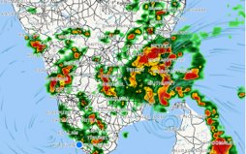
Phenomena quantified
Weather things
Covid-19 spread
Social network analysis

Slide 17
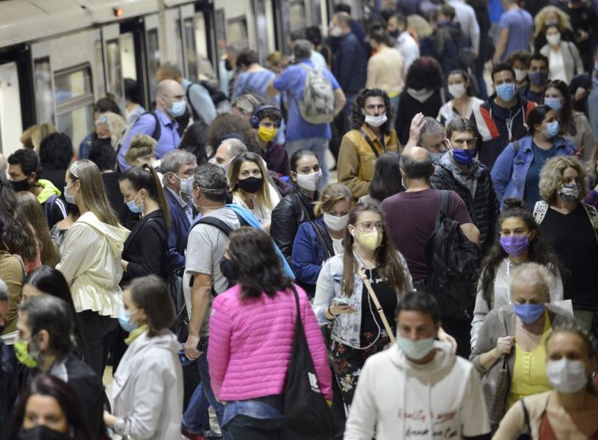
How do we describe phenomena?
text

Slide 18
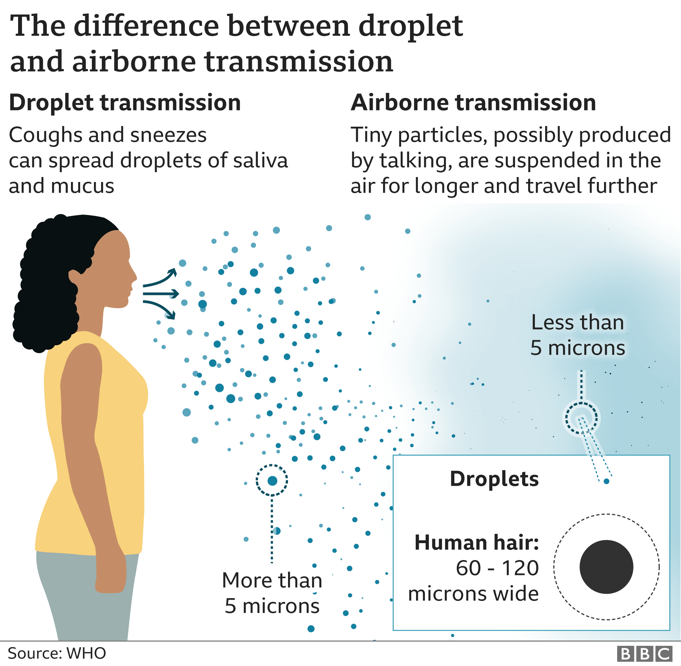
Phenomena quantified
Weather things
Covid-19 spread
Social network analysis

Slide 19
Phenomena quantified
https://gisanddata.maps.arcgis.com/apps/opsdashboard/index.html#/bda7594740fd40299423467b48e9ecf6
https://www.cdc.gov/coronavirus/2019-ncov/covid-data/forecasting-us.html

Slide 20
Bram in data; QS
You can also capture social and behavioural phenomena which emerge by the interaction of individuals with one another and environment:

Slide 21
How do we store and process data?
We’ll get into that next lecture
Now let’s look at the course approach and structure
Then we’ll have some hands-on work

Slide 22
Statistical Software
What we’re gonna use and why

Slide 23
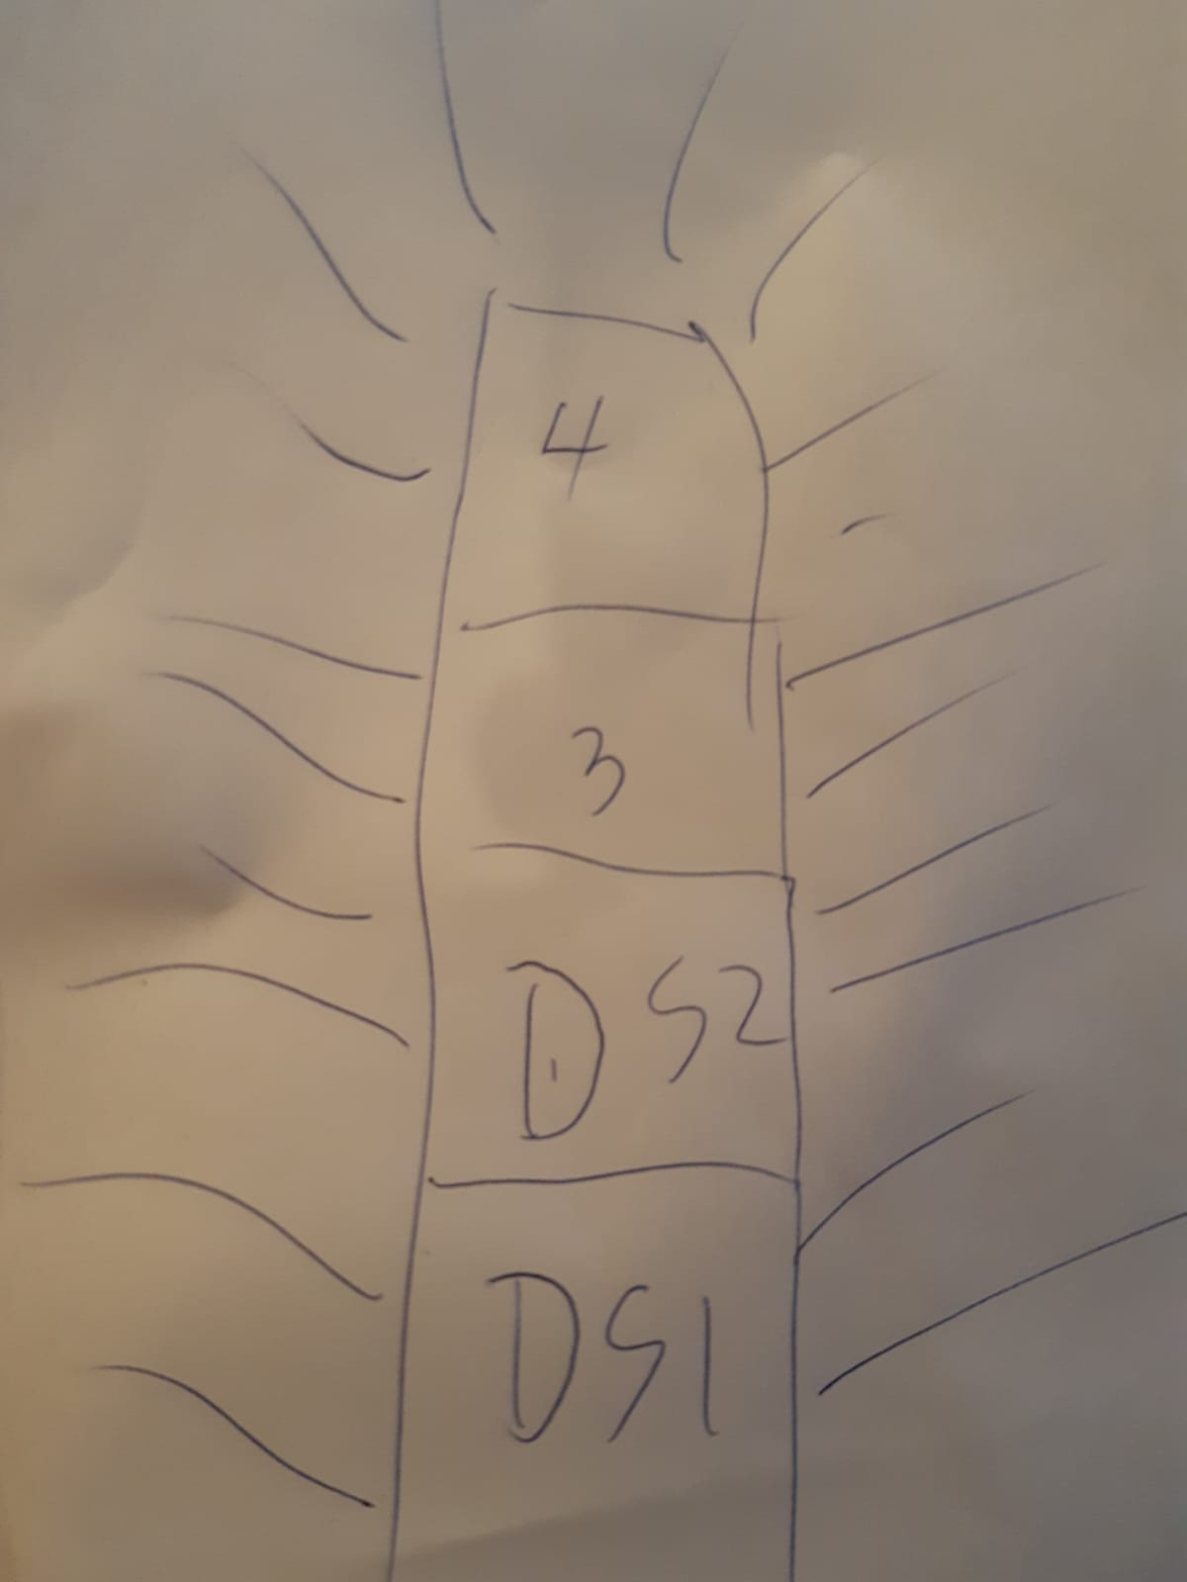
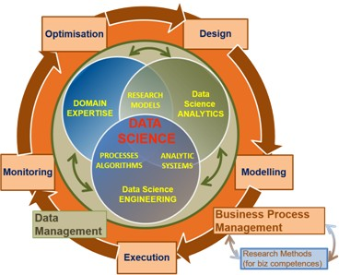
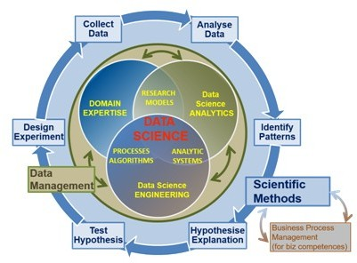
Educational Approach
Things
Notes:
Maybe too complex for block a, year 1

Slide 24
Course Approach
3 days a week where every course day is structured as follow:
Video-lecture for presenting and discussing the main concepts, using practical examples: 30 – 1 hours
Structured self-study at home or in Data Lab: 3 - 6
Working on assessment building-blocks at home or in Data Lab: 1 – 4 Hours

Slide 25
Course Content
Introduction to Data Science(codifying the world in data, attributes)
Variables (data frames, continuous, nominal, ordinal etc.)
Descriptive analyses (mean, sd, range, IQR) & visualisation (boxplots)
Introduction to Probability (random variable, distributions)
Introduction to statistical inference (sample, population, hypothesis testing)
Analysing Relationships between variables (e.g., compute correlation by hand)
Reporting & visualising (Academic Skills)
Introduction to regression & machine learning(supervised, unsupervised, the CRISP DM model)
Conference Poster Creation
You are here

Slide 26
Assessment
Create a Conference Poster based on case studies and examples introduced online and in-class; the focus is on all stages of the data science process (formulating the problem; selecting the data and exploratory data analyses technique(s); interpretation of descriptive data; reporting and visualizing the data) from an elementary level. Propose next steps: an analysis to run on the data.
Building blocks for the final poster are created at the end of each workshop day, they can be handed till the end of the day for feedback before assesment. Building blocks handed in after 9:00 are no-longer accepted.
[Link to assessment rubric]
Notes:
So there's only one assement: the datalab one.

Slide 27
Practical details
[Time & dates]

Slide 28
Any questions?
Ask me on Microsoft Teams, I reply during working hours.
You can also e-mail me at: Heijligers.b@buas.nl

